Slide 1
JAVA Constants and variables

Slide 2
Constants
A constant is an identifier that is similar to a variable except that it holds the same value during its entire existence
As the name implies, it is constant, not variable
In Java, we use the reserved word final in the declaration of a constant final int MIN_HEIGHT = 69;

Slide 3
Variables
A variable is a name for a location in memory
A variable must be declared by specifying the variable's name and the type of information that it will hold
int total;
int count, temp, result;

Slide 4
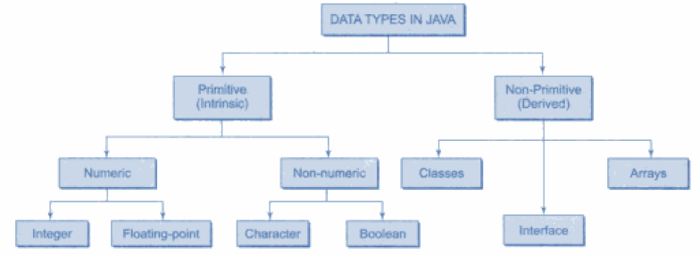
Data Types

Slide 5
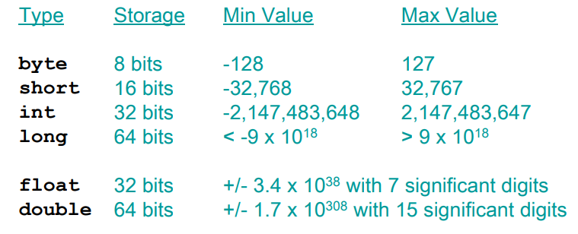
Data Types

Slide 6
Data Types
Char and Boolean
char in Java is 16 bit
Char ranges from 0 to 65536
Boolean is a primitive data type, it can either take true or false

Slide 7
Symbolic constant
symbolic constants are named constants like : final double PI = 3.14 ;
They are constants because of the 'final' keywords, so they cannot be reassigned a new value after being declared as final
A final variable declaration is qualified with the reserved word final.
The variable is set to a value in the declaration and cannot be reset. Any such attempt is caught at compile time.

Slide 8
Symbolic constant
public class Student{
public static final int NUM_GRADES = 5;
private String name;
private int[] grades;
public Student(String name){
this.name = name;
this.grades = new int[NUM_GRADES];
}
}

